Slide 1

Recognition of Handwriting Signature
Prashant Pratik
Matriculation Number : 1271359

Slide 2
Contents :
Introduction
K-Means Algorithm
LearningApi
Methods
Architecture
Implementation
Results
Discussion
References

Slide 3
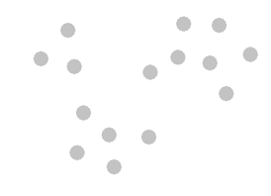
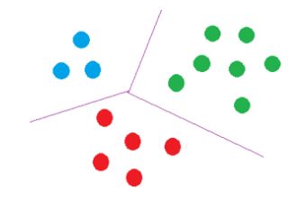
Introduction :
K-Means Algorithm :
The K-Means Clustering Algorithm is an unsupervised Machine Learning Algorithm. This algorithm basically categorizes a set of data into groups.
LearningApi :
LearningApi is a Machine Learning Foundation of useful libraries implemented in .NET Core developed by Frankfurt University of Applied Sciences. The K-Means Algorithm is already implemented and also extended as Function Recognition Algorithm in this foundation as a library named AnomDetect.KMeans. This library is directly used by MouseGestureRecognition application for recognition of gestures. Hence, we can say that LearningApi foundation provides the backbone for this application.

Slide 4
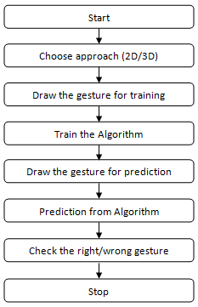
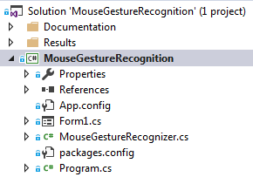
Methods :
Architecture :
The MouseGestureRecognition application is created as a Windows Form Application in .NET Framework and written in C# programming language.
Implementation :
The MouseGestureRecognition application is implemented in two classes, one is Form Class and other one is MouseGestureRecognizer Class. Basically, this is implemented by giving Clustering Settings, Training of Algorithm and Prediction from Algorithm.

Slide 5
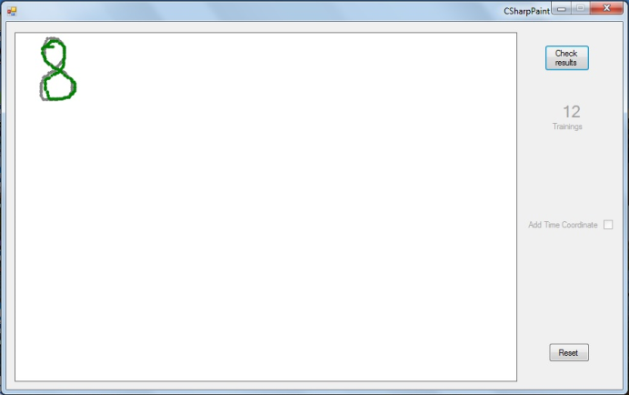
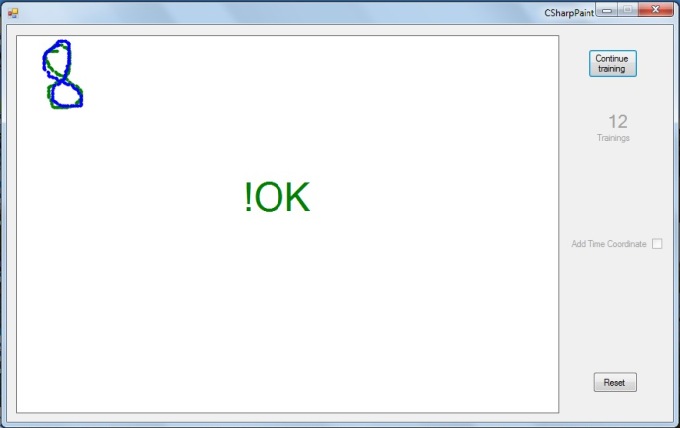
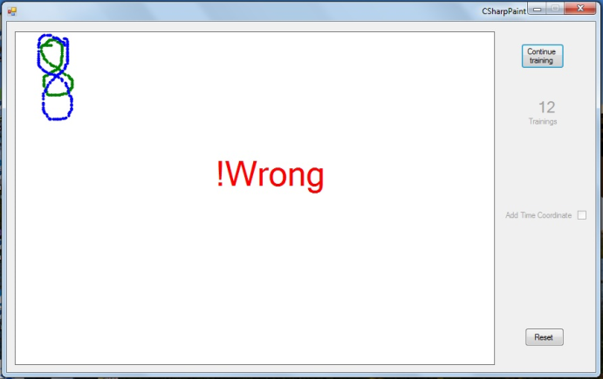
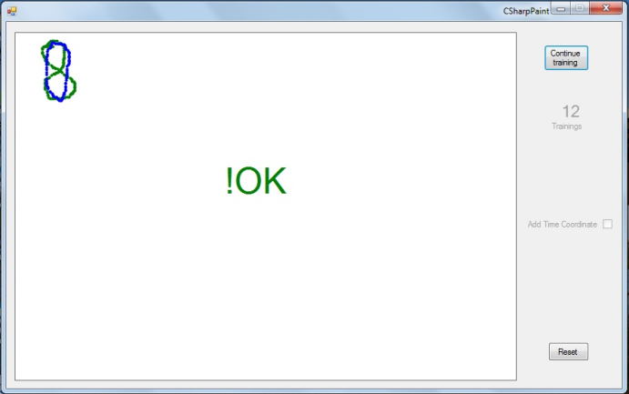
Results:
Without Time Approach (2D vectors) :
Trained Image.
Prediction 1.
Prediction 2.
Prediction 3.

Slide 6
Results:
With Time Approach (3D vectors) :
Prediction with Time (Animated Image).

Slide 7
Discussion:
Conclusion:
For some gestures 2D approach is working fine but for some others it is not.
By using 3D approach, same gesture which was giving incorrect results in 2D approach, is giving correct result.
We can say that 3D approach is better than 2D approach.
Adding time component in vector can improve its recognition efficiency.
Disadvantage:
The time component in 3D approach can dominate over space coordinates and this can also give incorrect result.
Future Perspectives:
One can work on making a balance between time and space coordinates to make the recognition efficient.
One can also improve the centre problem that current application is facing. The same gesture if drawn in different parts of picture box, gives incorrect results.

Slide 8
References:
NCSS Statistical Software, "K-Means Clustering," [Online]. Available: https://ncss-wpengine.netdna-ssl.com/wp-content/themes/ncss/pdf/Procedures/NCSS/K-Means_Clustering.pdf. [Accessed 2019].
healthcare.ai, "Step by Step to K-Means Clustering," [Online]. Available: https://healthcare.ai/step-step-k-means-clustering/. [Accessed 2019].
Frankfurt, University of Applied Sciences, "LearningApi," 2019. [Online]. Available: https://github.com/UniversityOfAppliedSciencesFrankfurt/LearningApi. [Accessed 2019].
Frankfurt, University of Applied Sciences, "AnomDetect.KMeans," 2019. [Online]. Available: https://github.com/UniversityOfAppliedSciencesFrankfurt/LearningApi/tree/KMeans-branch/LearningApi/src/MLAlgorithms/AnomDetect.KMeans. [Accessed 2019].
A. M. Baswade and P. S. Nalwade, "Selection of Initial Centroids for k-Means Algorithm," 2013. [Online]. Available: https://www.ijcsmc.com/docs/papers/July2013/V2I7201338.pdf. [Accessed 2019].

Slide 9
Thank You

